Slide 1
Reporting
Offensive Security

Slide 2
Reporting
Documents that are the result of an assessment
Remember in the beginning…
Reporting happens throughout the entire process
You don’t have to follow the following report types or sections exactly as they are
REMEMBER, This is what the customer is paying for

Slide 3
Quality Report
A well written report is important
Always have proofreaders
Consistency
Spell/Grammar check
Screenshots
Show what is important, don’t go overboard
Make sure they are good pictures, you don’t need the whole screen to show a few lines of output
Change your terminal to 0 transparency
Do not include pages of tool output
If you include tool output show what is important

Slide 4
Types of Reports
Final Report
Hot wash (Daily)
After Action Report (AAR)
Plan of Action and Milestone (POA&M)
Ad-hoc/Situational
Deconfliction
Halting

Slide 5
Final Report Sections
Executive Summary
Narrative/Methodology
Findings
Impact
Remediation
Summary
Appendices

Slide 6
Executive Summary
Overview of the assessment and the findings
Big picture vulnerabilities and impacts
How could this cost them money?
Short and to the point
No technical details
Audience matters
The person who reads the executive summary may not read the findings

Slide 7
Narrative/Methodology
Why are you doing what you are doing?
How did you go about performing the test?
Talk about the process you used
Add in some good findings too
Connect the process to the customers network
”This is what we saw on the customers network when we were working on this phase”

Slide 8
Findings
Meat of the report
Written for administrators, developers, etc.
Details
Title
Description
Severity
Impact
Mitigation/Remediation
Where is it found?
Don’t have 100 findings for the same bug

Slide 9
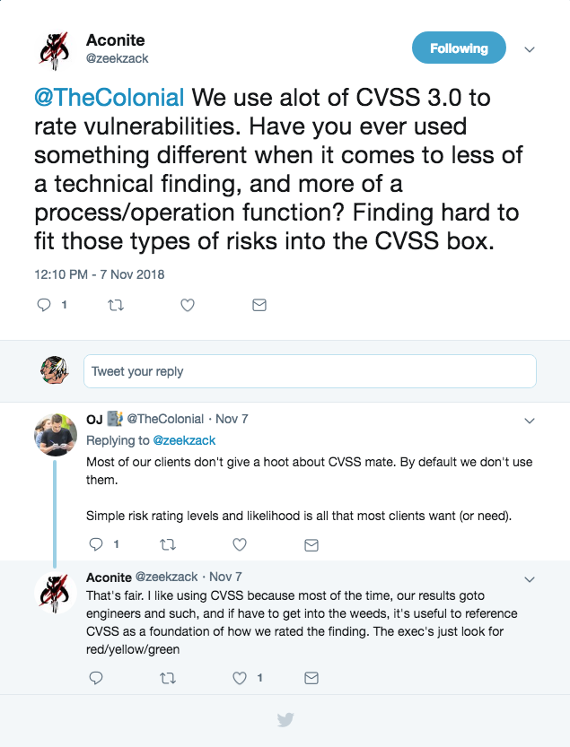
Rating Vulnerabilities
Depends on audience
Sometimes Low-High is fine
Other times CVSS 3.0
https://www.first.org/cvss/calculator/3.0

Slide 10
Remediation
Provide a plan to fix the issues you identify
How to fix the vulnerabilities
Bug fix in code
Change a configuration
Relate back to scoring to know which to fix first
Remember, they did the best they could with what they had at the time

Slide 11
Summary & Appendices
Summary of the assessment
Should echo what is said in executive summary and narrative
Appendices
If you need more output from a tool this is where it goes
More screenshots
More technical details

